Slide 1
8051 MICROCONTROLLER I
Monika YADAV
EEE DEPT
SOE, UPES DEHRADUN

Slide 2
INTRODUCTION
In addition to the features found in Microprocessor CPU, it also has ROM, RAM , parallel I/O, serial I/O, counters and a clock circuit.
True computer on a chip.
Its prime use is to control the operation of a machine using a fixed program that is stored in ROM and that does not change over the lifetime of the system.
Applications: Printer, Toaster, Automobile Engine Control, Motor Speed Control

Slide 3
COMPARISON
MICROPROCESSOR | MICROCONTROLLER
No internal memory. | Contains RAM/ROM.
No interfacing circuits or counters or timers. | Contains serial I/O, parallel I/O, and counters.
Has many opcodes for moving data from external memory to CPU. | Has one or two opcodes.
Has one or two types of bit handling instructions. | They have many.
Concerned with rapid movement of code and data from external memory to CPU. | Concerned with rapid movement of bits within chip.
Must have many additional parts to be operational.(FD, K/B, CRT, etc) | Can function as a computer with no addition of external digital parts.
It is meant to fetch data, perform extensive calculations on that, and then store those calculations on mass storage devices or display the results for human use. | It is meant to fetch data, perform limited calculations on that data, and control its environment based on that calculation.
VON NEUMAN ARCHITECTURE | HARVARD ARCHITECTURE

Slide 4
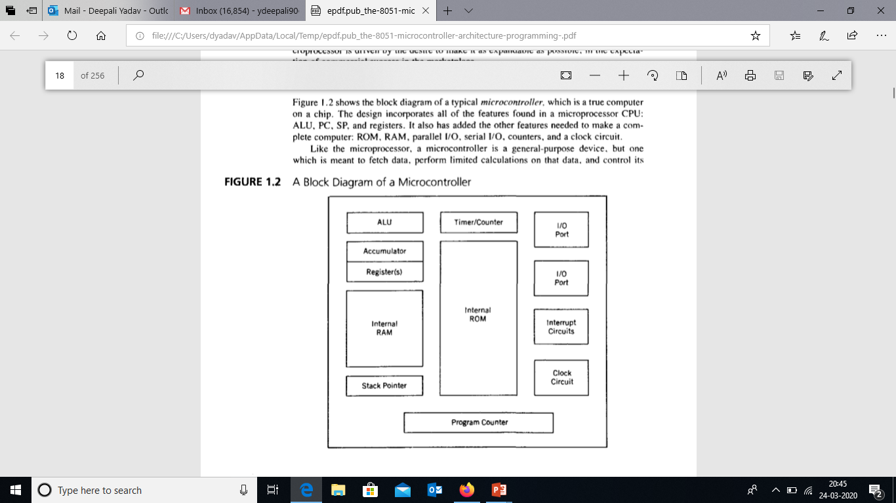

Slide 5
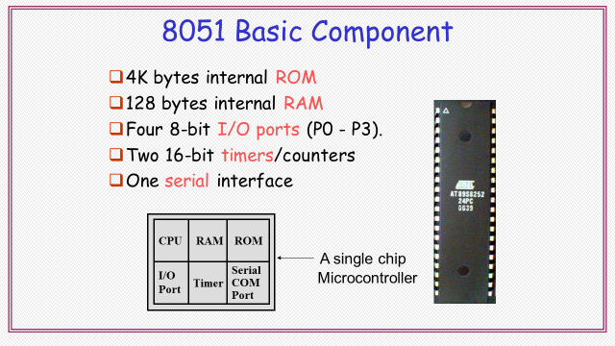
architecture

Slide 6
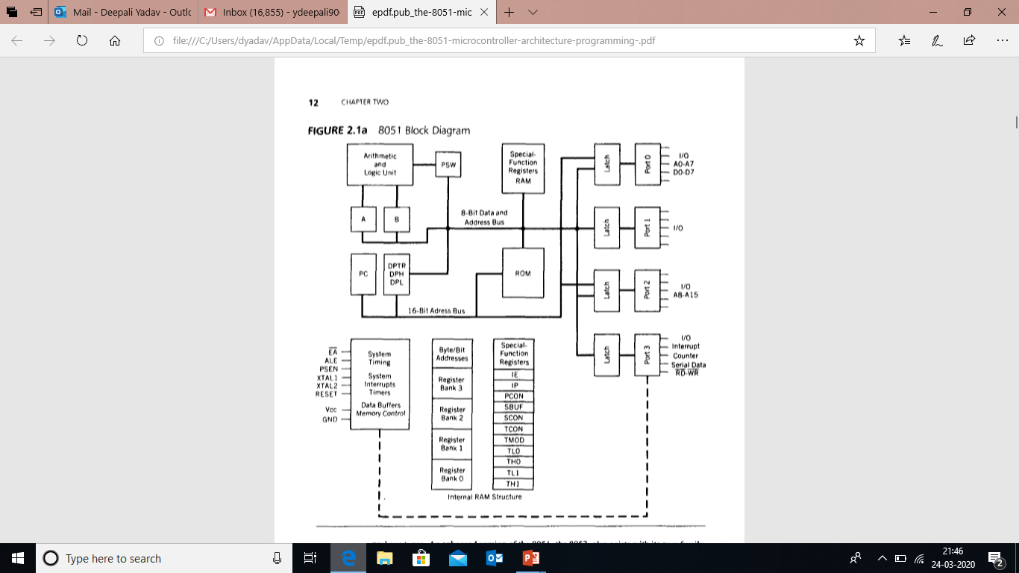

Slide 7
ARCHITECTURE | 8051
TOTAL PINS | 40
ADDRESS PINS | 16
DATA PINS | 8
INTERRUPT PINS | 2
I/O PINS | 32
8 BIT REGISTERS | 34
16 BIT REGISTERS | 2
STACK SIZE | 128
INTERNAL ROM | 4K
INTERNAL RAM | 128 BYTES
EXTERNAL MEMORY | 128 K
FLAGS | 4
TIMERS | 2
PARALLEL PORT | 4
SERIAL PORT | 1

Slide 8
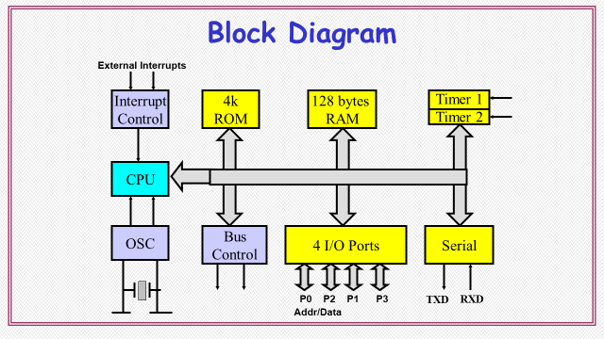

Slide 9
A | 8 Bit register- Accumulator
B | 8 bit register
PC | 16 bit program counter
DPTR DPH DPL | 16 bit data pointer
PSW | 8 bit program status word
RAM | Internal RAM of 128 Bytes- 4 register banks each containing 8 registers, 16 bytes, 8 bytes of G.P. data m/m
ROM | Internal ROM or EPROM
P0 to P3 | 32 I/O pins arranged as four 8 bit ports
T0 & T1 | Two 16 bit timer/counter
SBUF | Full duplex serial data receiver/transmitter
TCON,TMOD, SCON, PCON,IP, IE | Control registers
XTAL1, XTAL 2 | For connecting resonant network to form an oscillator
PSEN | 64K external code (program) memory(only read) Program Store Enable
EA’ | To select external code memory

Slide 10
8051 has 8 bit and 16 bit registers.
8 bit memory locations.
Each register except PC has a 1 byte address assigned to it.
Some registers are both bit and byte addressable.
Oscillator & clock circuits.
2 External Interrupt Sources (also has 3 internal interrupt sources, 1 Reset)

Slide 11
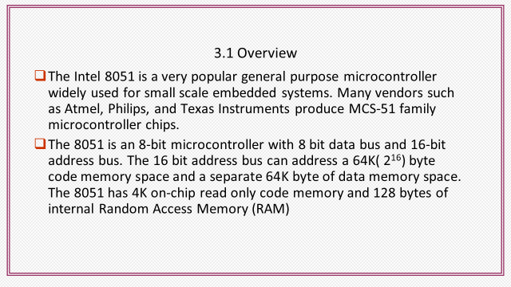

Slide 12
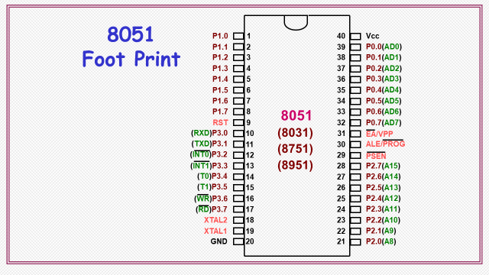

Slide 13
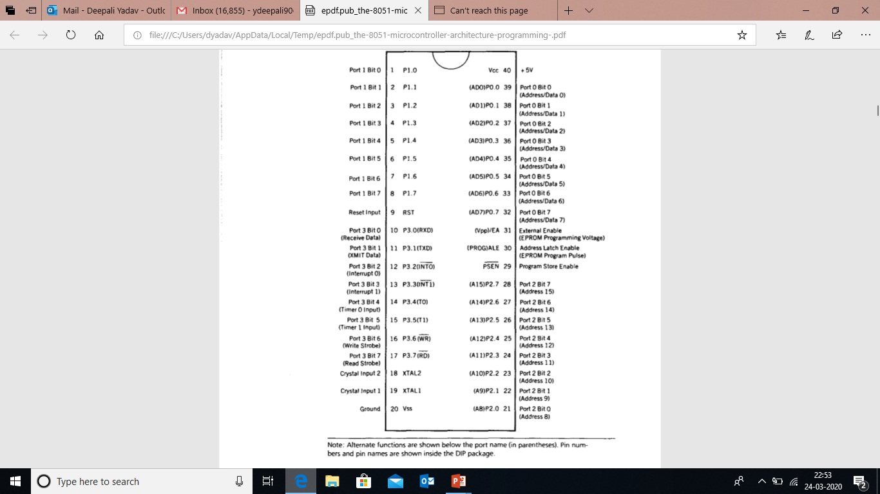

Slide 14
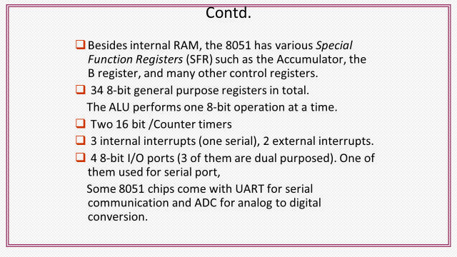

Slide 15
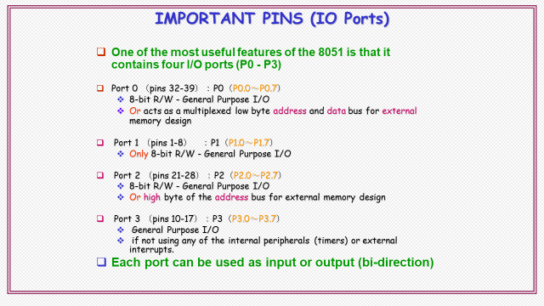

Slide 16
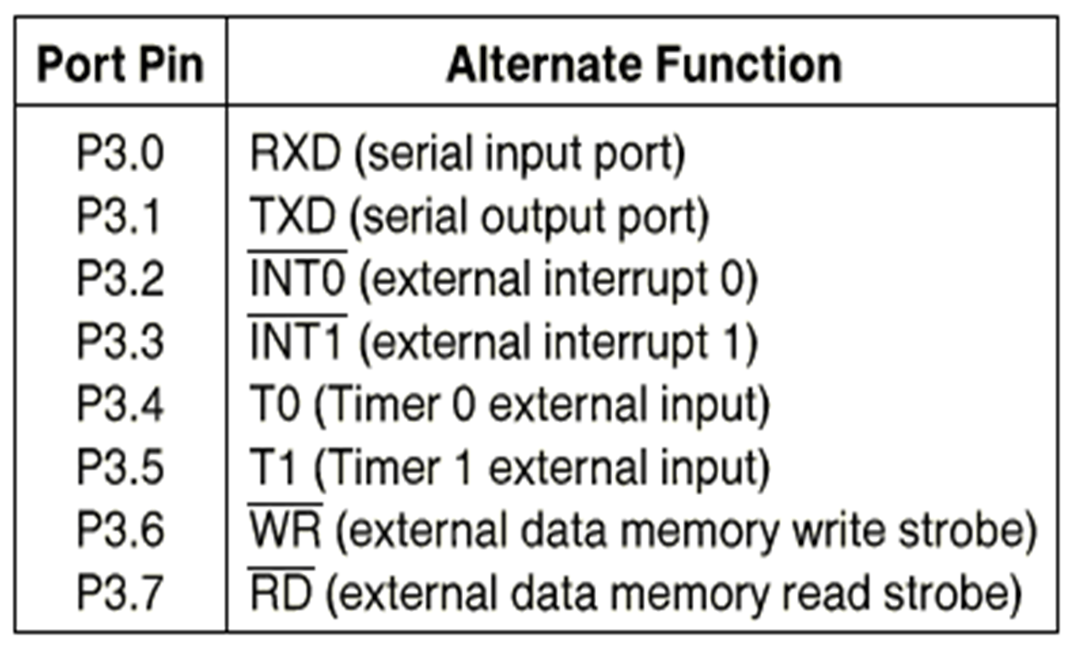

Slide 17
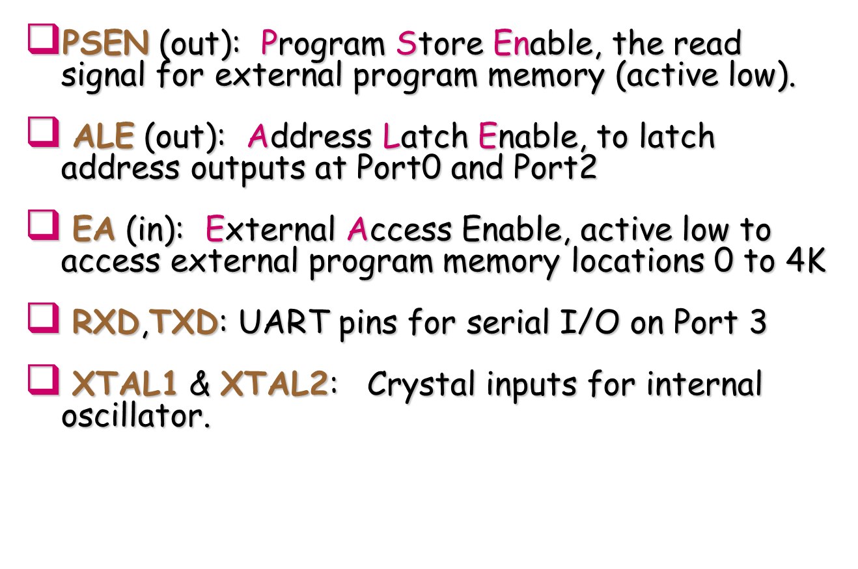

Slide 18
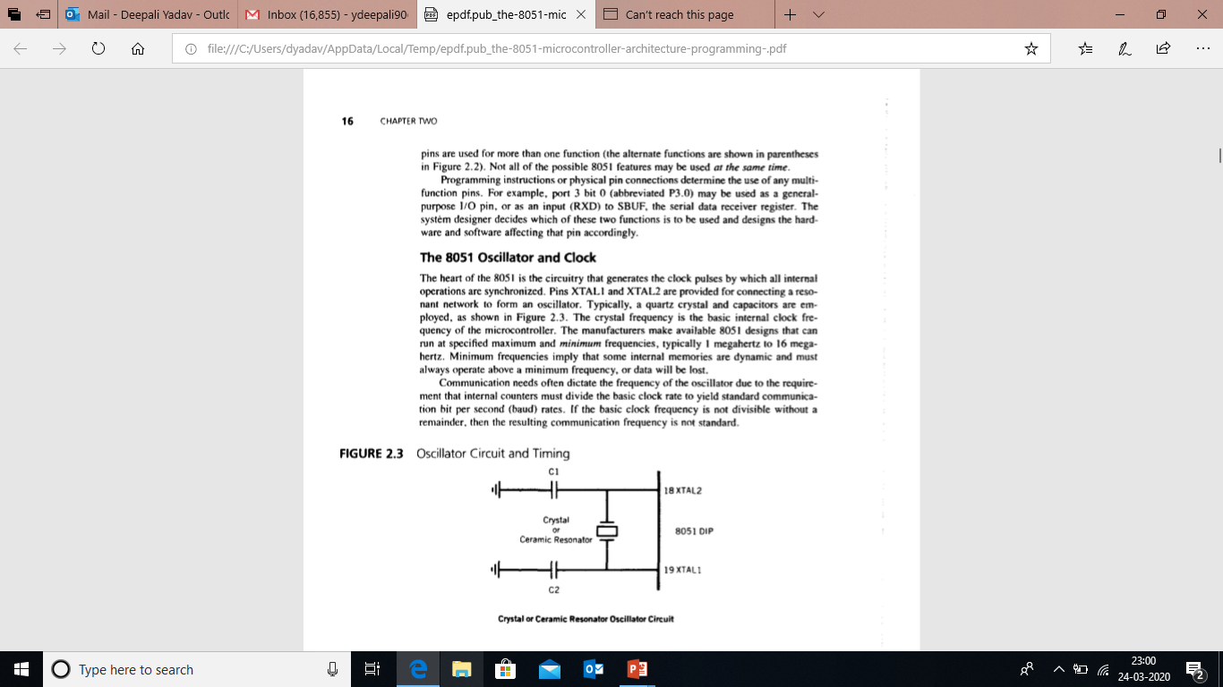
8051 Oscillator & clock

Slide 20
PC & DATA POINTER
16 bit registers
PC is Used to hold the address of a byte in memory
Program instruction bytes are fetched from locations in memory that are addressed by PC.
Program ROM may be on the chip at addresses 0000 H to 0FFF H, external to the chip for addresses that exceed 0FFF H or totally external for all addresses from 0000 H to FFFF H.
The PC is automatically incremented after every instruction byte is fetched and may also be altered by certain instructions.
PC is the only register that does not have an internal address.
DPTR is made of 2 8-bit registers DPH and DPL.
They are used to furnish memory addresses for internal and external code access and external data access.
DPTR is under the control of program instructions.
DPTR does not have single internal address (DPL & DPH are each assigned an address).

Slide 21
A & b cpu registers
34 GPR
2 of these are A & B- mathematical core registers
Other 32 arranged as part of internal RAM as four banks of registers, B0 to B3, of 8 registers each, named R0 to R7.
A- addition, subtraction, integer multiplication, division, Boolean bit manipulations, data transfer between 8051 & external memory
B- used with A register, or to store data

Slide 22
FLAGS & program status word (psw)
FLAGS are 1 bit registers provided to store the result of certain program instructions.
Other instructions can test condition of flags and make decisions based upon the flag states.
Flags are grouped inside PSW & PCON (power control) registers.
8051 has 4(math flags) + 3(general purpose user) = 7 flags.
Math flags respond automatically to the output of math operations ( carry C, auxiliary carry AC, overflow OV and parity P).
G.P.F. can be set to 1 or cleared to 0by the programmer as desired (F0, GF0 & GF1).
All flags can be set or cleared by programmer at will.(math flags?)

Slide 23
Continued…
PSW contains
Math flags
User program flags F0
Register select bits ( selects which of the 4 GPR banks are in use by program)
*GF0 & GF1 are stored in PCON.

Slide 24
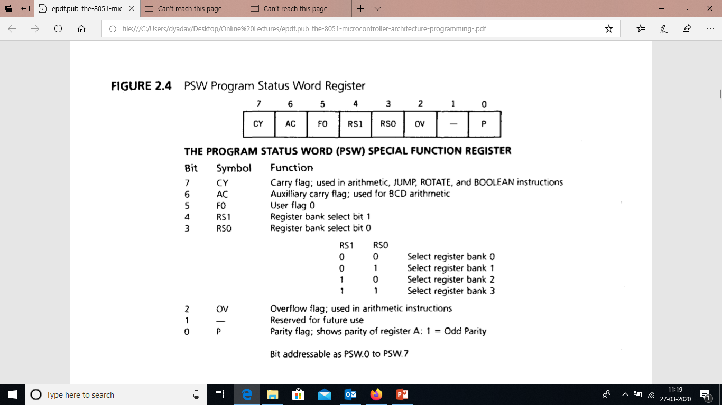
Psw register
Truth table for register select bits

Slide 25
Internal memory
Separate memory for program and code.
Harvard architecture(same address in different memories).

Slide 26
Internal ram
128 byte internal RAM.(starting and ending address ? )
32 B from address 00H to 1F H that make 32 working registers organized as four register banks (0 to 3).
Each bank has 8 registers R0 to R7.
Each register can be addressed by name (how) or by RAM address (address of R0 of bank 3 ? )
Register banks which are not selected can be used as general purpose RAM.
RESET selects bank 0.
A bit addressable area of 16 bytes occupies RAM byte addresses 20 H to 2F H (forming 128 addressable bits).
A general purpose RAM area above bit area addresses from 30 H to 7F H.

Slide 27
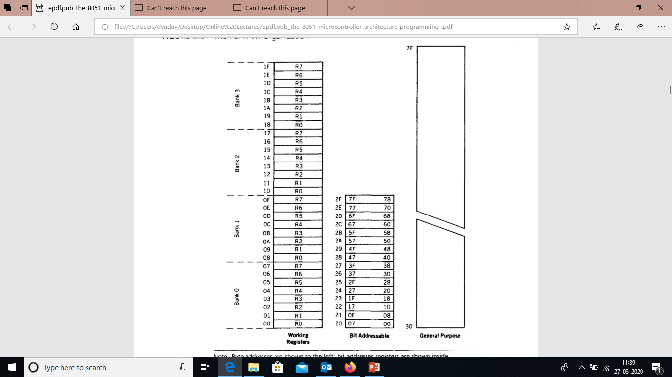
Continued…
Internal RAM organization

Slide 28
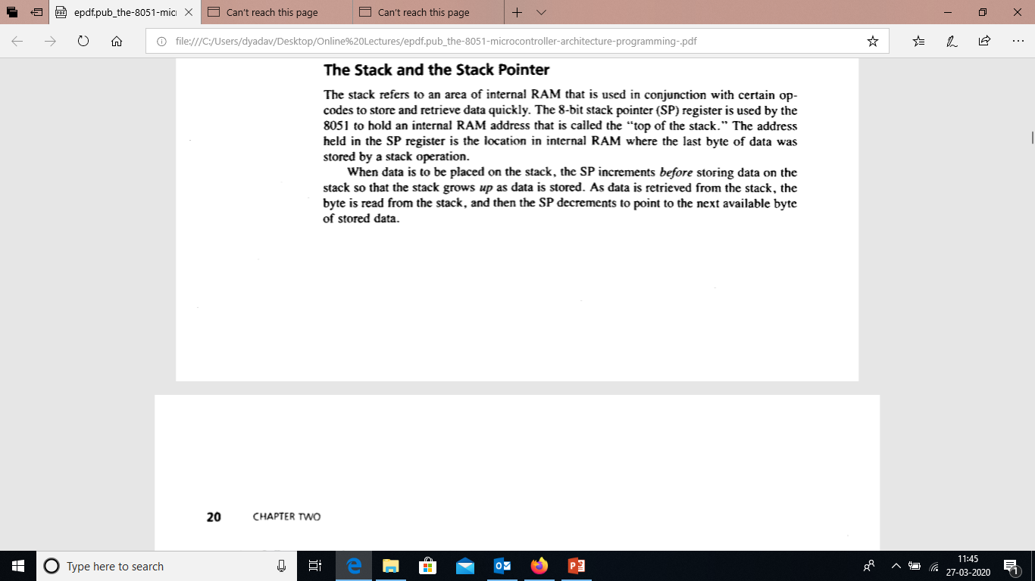
Stack & stack pointer
Stack refers to an area internal to RAM that is used in conjunction with certain opcodes to store and retrieve data quickly.
The 8 bit SP register holds an internal RAM address that is called the “ top of the stack”.
This is that address location in RAM where the last byte of data was stored by a stack operation. (last in at top)

Slide 29
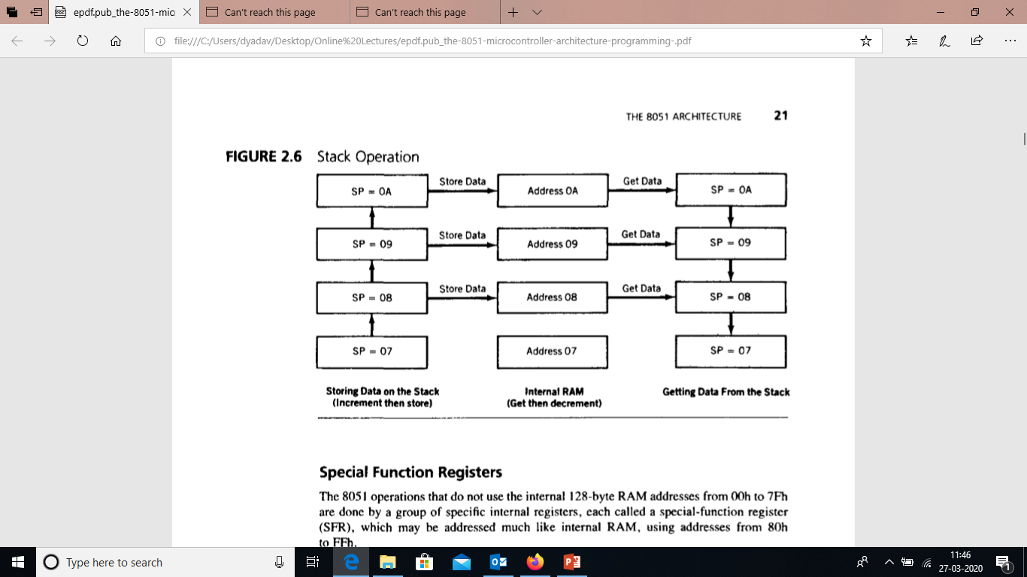
Stack operation

Slide 30
Special function registers
SFR is used for operations where internal 128 B RAM addresses ( 00 H to 7F H) are not used.
These are addressed from 80 H to FF H*.
Some SFRs are bit addressable.

Slide 31
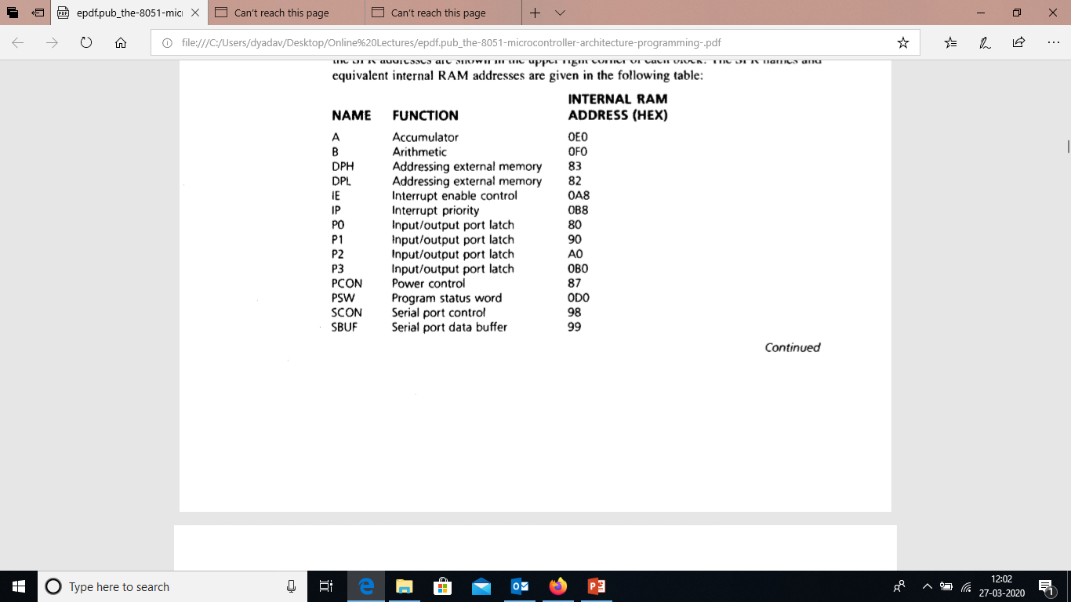
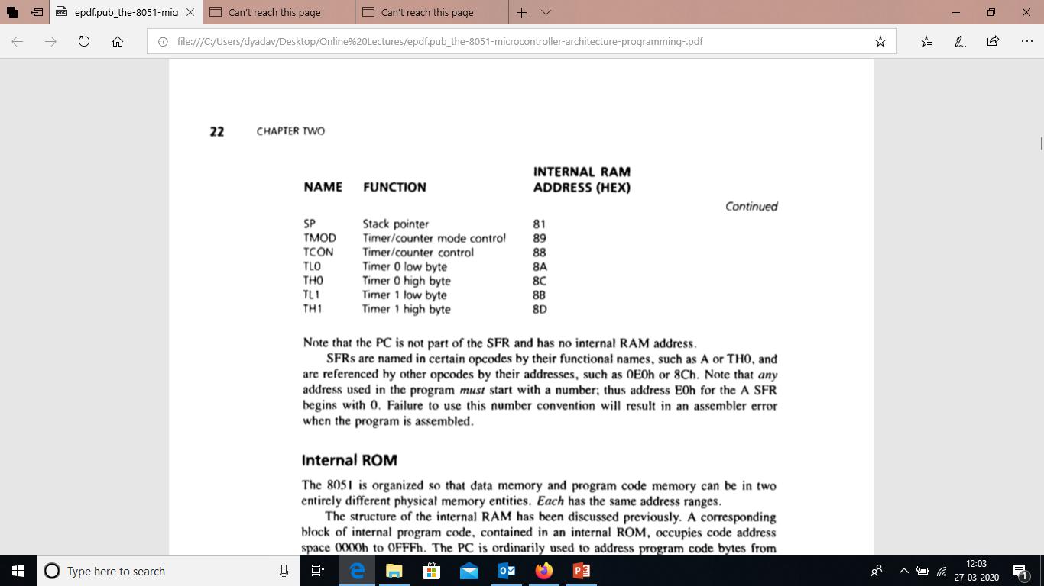
SFR with addresses
PC ????
How to name SFRs in PROGRAMS???
Some addresses start with 0… ?????

Slide 33
Internal rom
Used for program code.
It occupies code address space form 0000 H to 0FFF H. (4K ROM)
PC addresses program code bytes form 0000 H to FFFF H. ( ? )
EA’ (pin 31)

Slide 34
i/o pins, ports & circuits
40 pin DIP.
24 pins are dual function pins.
Thus, effective pin configuration becomes 64.
The function a pin performs at an instant depends on what is physically connected to it and what software commands are used to program the pin. (programmer & circuit designer)
Each port has a D-type output latch for each pin.
The SFR at that port is made up of these eight latches.
It can be addressed at SFR address at that port.
Eight latches for port 0 are addressed at 80 H.
Port 0 Pin 3 is the bit 2 of the Port 0 SFR.
The port latches should not be confused with port pins.

Slide 35
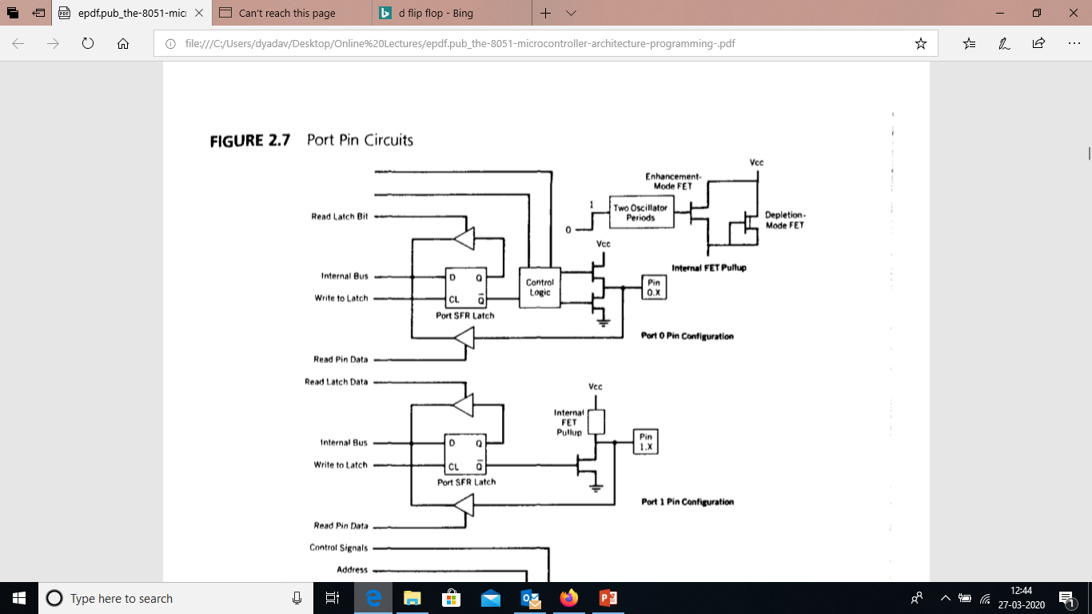
Upper buffer for latch bit
D-Type latch
Lower buffer for pin data

Slide 36
Port 0
Serves as inputs, outputs or when used together as bi-directional low order address and data bus for external memory.

Slide 37
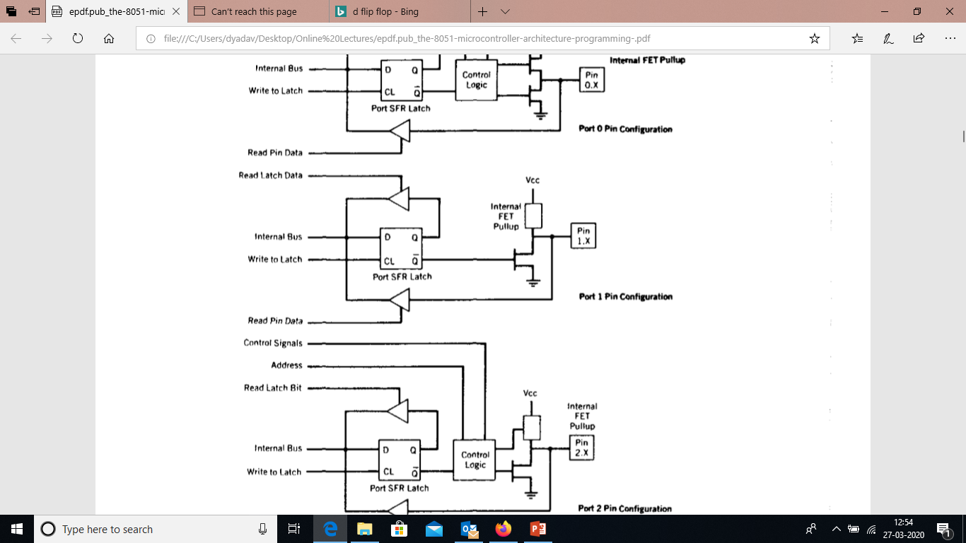
Port 1
No dual functions.

Slide 38
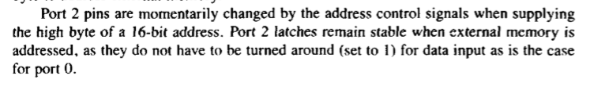
Port 2
Maybe used as I/O port.
Alternatively used to supply higher order address byte in conjunction with Port 0 lower order byte to address external memory.

Slide 39
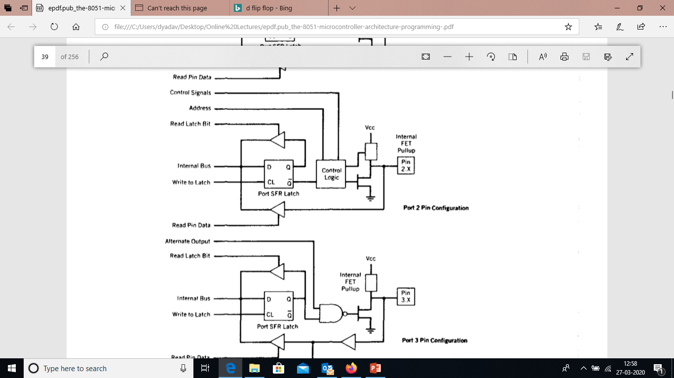

Slide 40
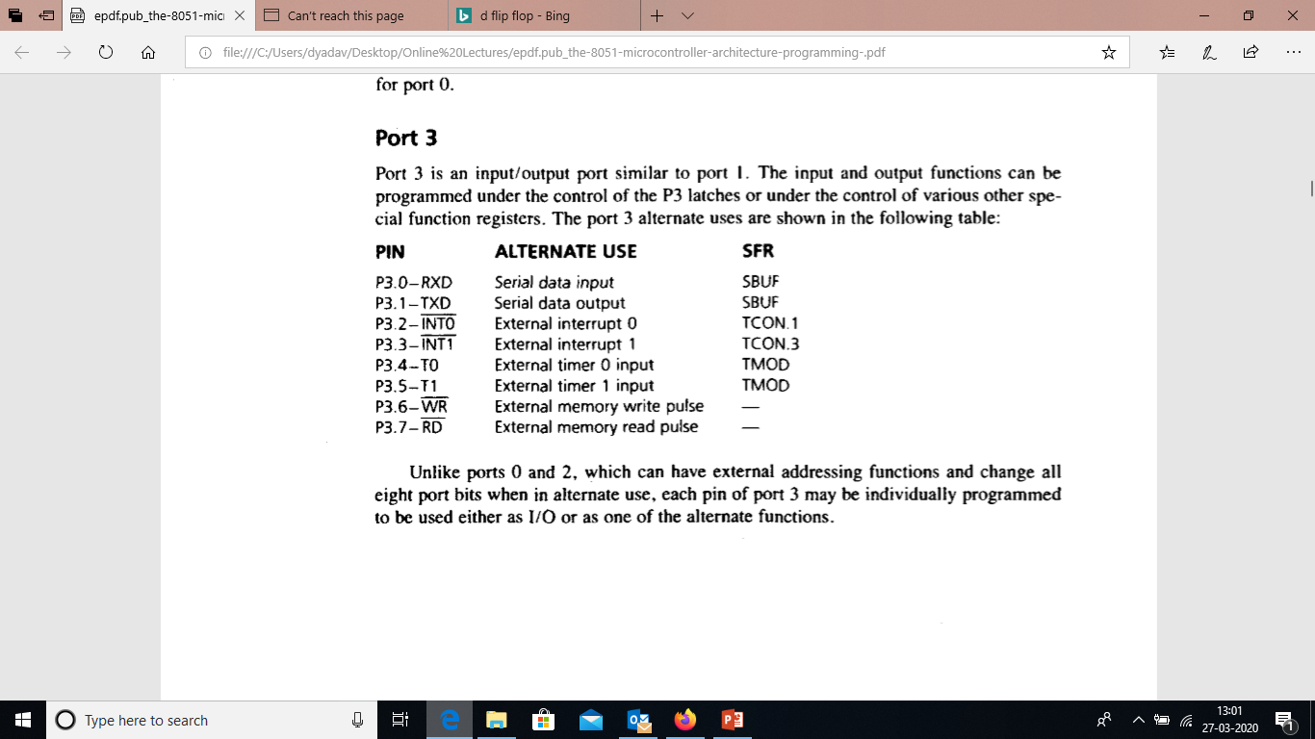
Port 3
I/O port similar to port 1.
Under the control of P3 latches or of SFRs the I/O functions can be programmed for alternate use.

Slide 41
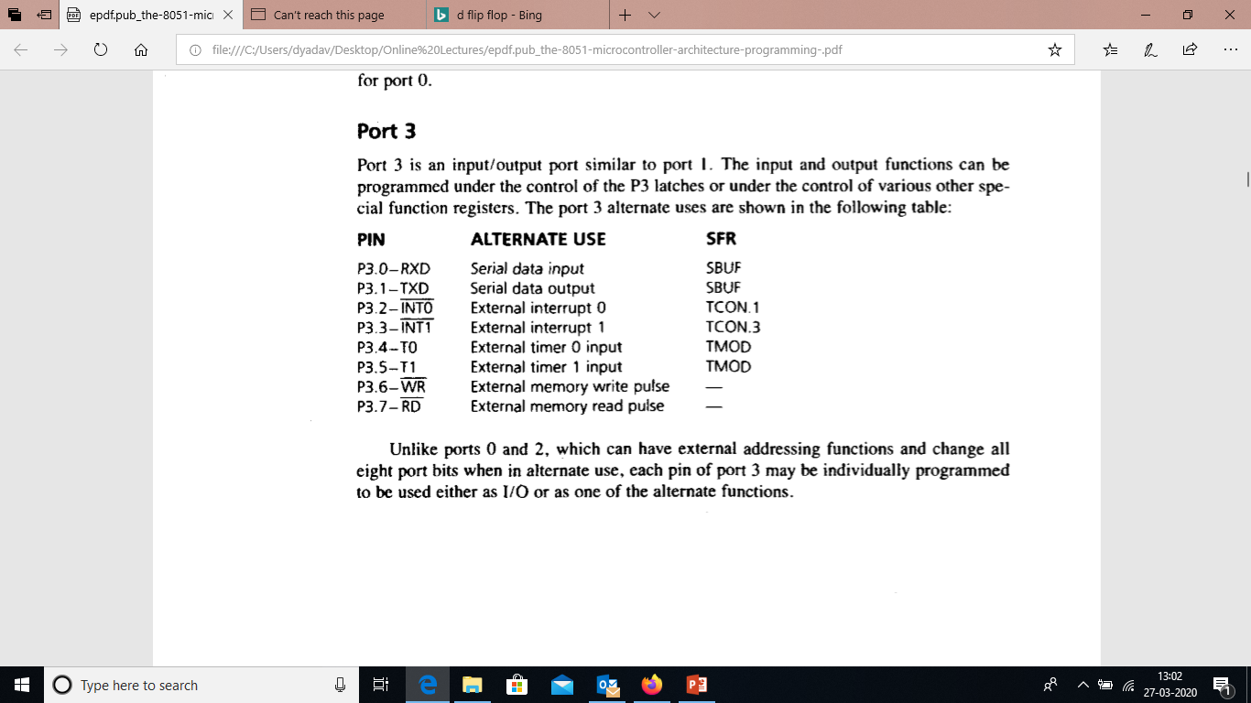

Slide 42
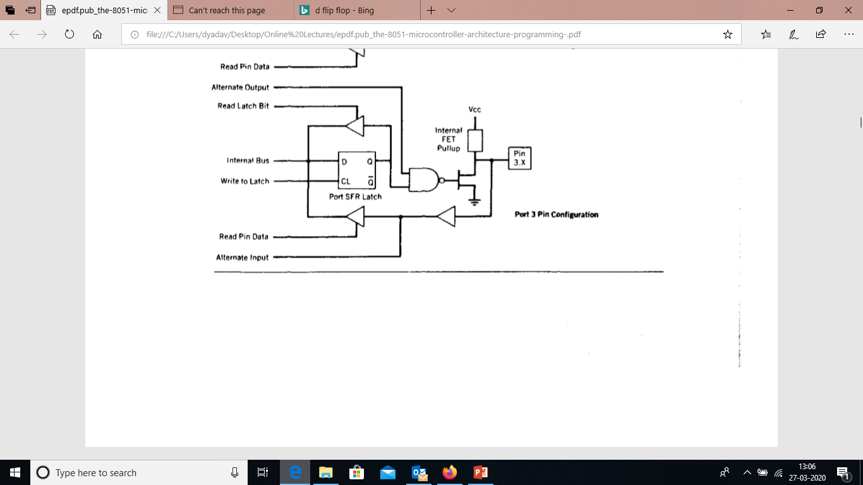

Slide 43
External memory
Memory not limited by 128B RAM or 4K ROM.
2 separate external memory spaces can be made available by PC & DPTR.
External control pins can be used to enable external RAM & ROM.
Capacity of each 64KB.

Slide 44
Counters & timers
For counting of external events
For this purpose 2 16-bit up counters named, T0 & T1 are provided (processor relieved)
Each can count internal clock pulses (timer) and also programmed to count external clock pulses(counter).
These are divided into two 8-bit registers called called timer low (TL0, TL1) and timer high (TH0, TH1).
All counter actions are controlled by bit states in the timer mode control register TMOD, the timer/counter control register TCON and certain program instructions.
TMOD is solely dedicated to two timers and can be considered to be two duplicate 4-bit registers each of which controls the action of one of the timers.
TCON has control bits or flags for the timers in the upper nibble and control bits and flags for the external interrupts in the lower nibble.

Slide 45
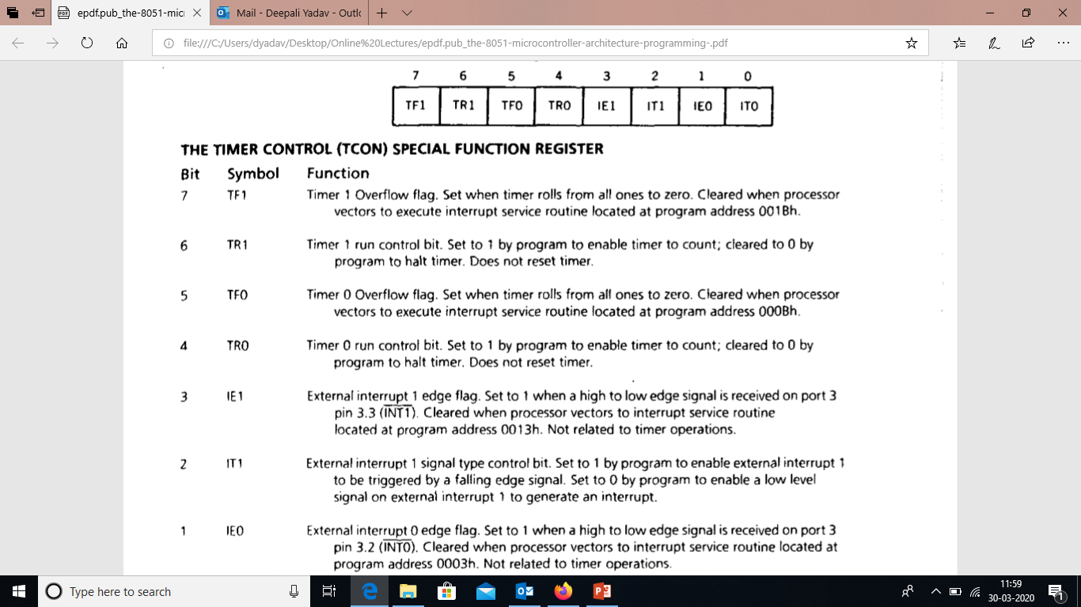

Slide 46
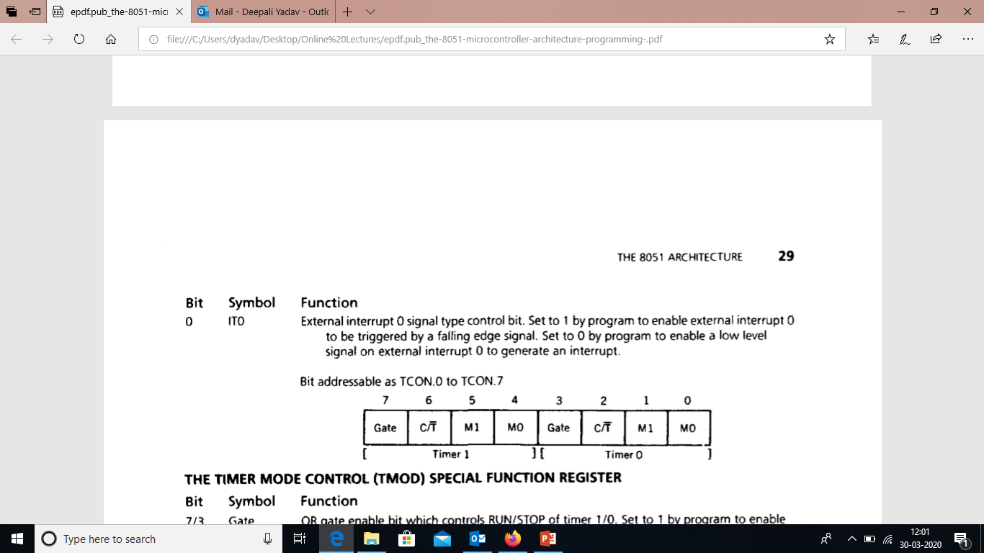
Continued…

Slide 47
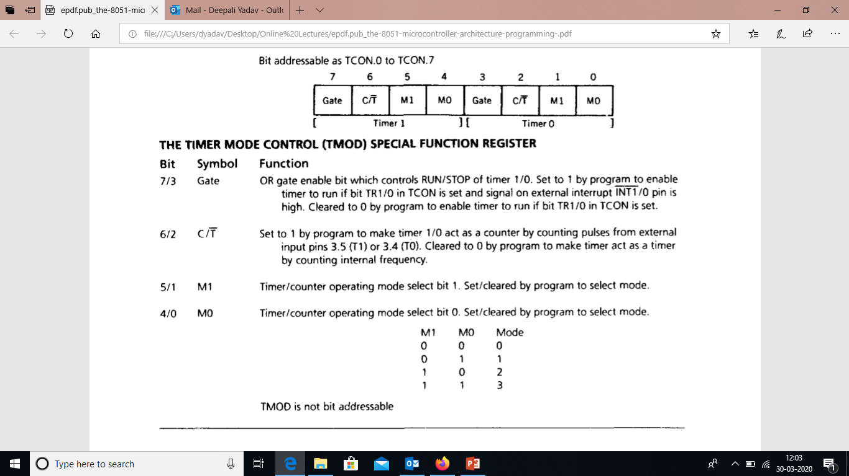

Slide 48
Serial data input/output
Serial data communication--- cost effective way
8051 uses SBUF register to hold data
SCON controls data communication
PCON controls data rate
RXD (P3.0) & TXD (P3.1) connect to the serial data network.

Slide 49
sbuf
Physically two registers, one is write only to hold data to be transmitted out via TXD.
Other is read only and holds received data from external sources via RXD.
Both use address 99H.

Slide 50
SCON
SCON consists of SMX bits.
SMX bits are used to select four programmable modes for serial data communication.

Slide 51
interrupts
These are hardware signals, that force the program to call a subroutine.
8051- 5 interrupts
Timer flag 0, timer flag 1 & serial port interrupt – generated automatically by internal operations.
INT0’ & INT1’ are triggered by external signals provided by circuitry connected to their pins.
The programmer can alter the control bits in IE register, IP register and timer control register TCON

Slide 52
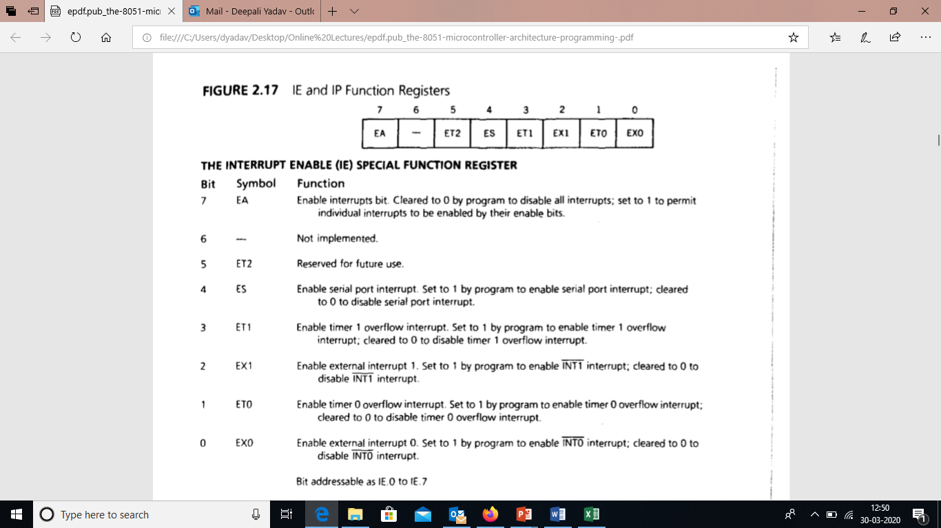

Slide 53
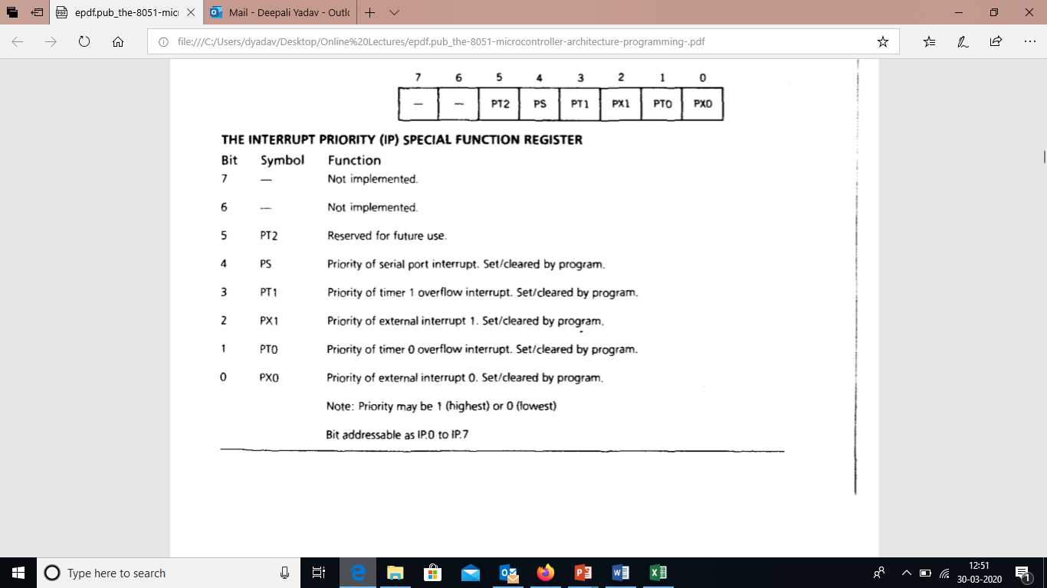

Slide 54
